Slide 1

SOLID
Ashutosh

Slide 2



Agenda
Principle vs patterns
SOLID
Demo of each principle

Slide 3
Principles vs Patterns
Principles
patterns
Design principles are core abstract principles that we are supposed to follow while designing software.
Software design principles represent a set of guidelines that help us to avoid having a bad design. like: Open Close Principle
Patterns are common solutions to object-oriented programming problems.
Design Pattern is a general reusable solution to a commonly occurring problem within a given context in software design. Like: Singleton

Slide 4




Introduction
SOLID principles are the design principles that enable us to manage most of the software design problems. These principles provide us with ways to move from tightly coupled code and little encapsulation to the desired results of loosely coupled and encapsulated real needs of a business properly.

Slide 5
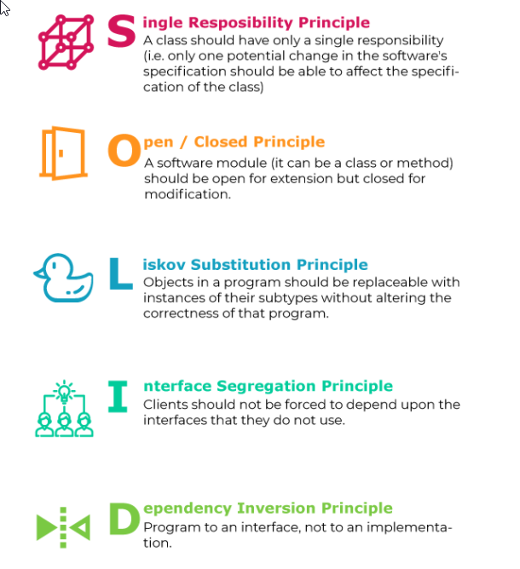

SOLID
Subtitle

Slide 6

Accessibility Ease of refactoring Extensibility Debugging Readability Easy to Write UT

Slide 7
Single Responsibility Principle (SRP)
Class should have only a single reason to change throughout its lifetime.
This principle ensures that a class exists only for a single reason but can have multiple methods to carry out distinct functions.
Notes:
Separation of concern

Slide 8
Cohesion
Relation of responsibilities
Focused on one task
Coupling
Dependency on other modules
Relationship between modules
Ideal – low coupling/string cohesion

Slide 9
Solution
Multiple small interfaces (ISP)
Many small classes
Distinct responsibilities
Result
Flexible design
higher cohesion

Slide 10
Single Responsibility Live Demo

Slide 11
Open and Closed Principle
Objects should be open for extension but closed for modification.
The open and close principle ensures our code is easily extensible without editing or rewriting the existing codebase.

Slide 12
Change behavior without changing code?
Rely on abstraction, not implementations
Do not limit the variety of implementations
In .Net
Interfaces
Abstract classes

Slide 13
Classic violations
Each change requires re-testing
Cascading changes through modules
Logic depends on conditional statement
Classic solution
New classes (not coupling)
Abstract classes

Slide 14
Approaches to achieve OCP
Parameters
Pass delegates / callback
Inheritance
Child types override behavior of a base class
Composition / Strategy pattern
Client code depends on abstraction
“Plug in” model

Slide 15
Open / Closed Live Demo

Slide 16
Liskov Substitution Principle
A section of your code is extending a superclass, then all subclasses of the superclass should be able to replace the superclass in your code.
A section of your code does not have to know which class it is as far as it is a superclass subclass.

Slide 17
Substitutability – child class must not
Remove base class behavior
Violate base class invariants
Normal OOP inheritance
IS-A Relationship

Slide 18
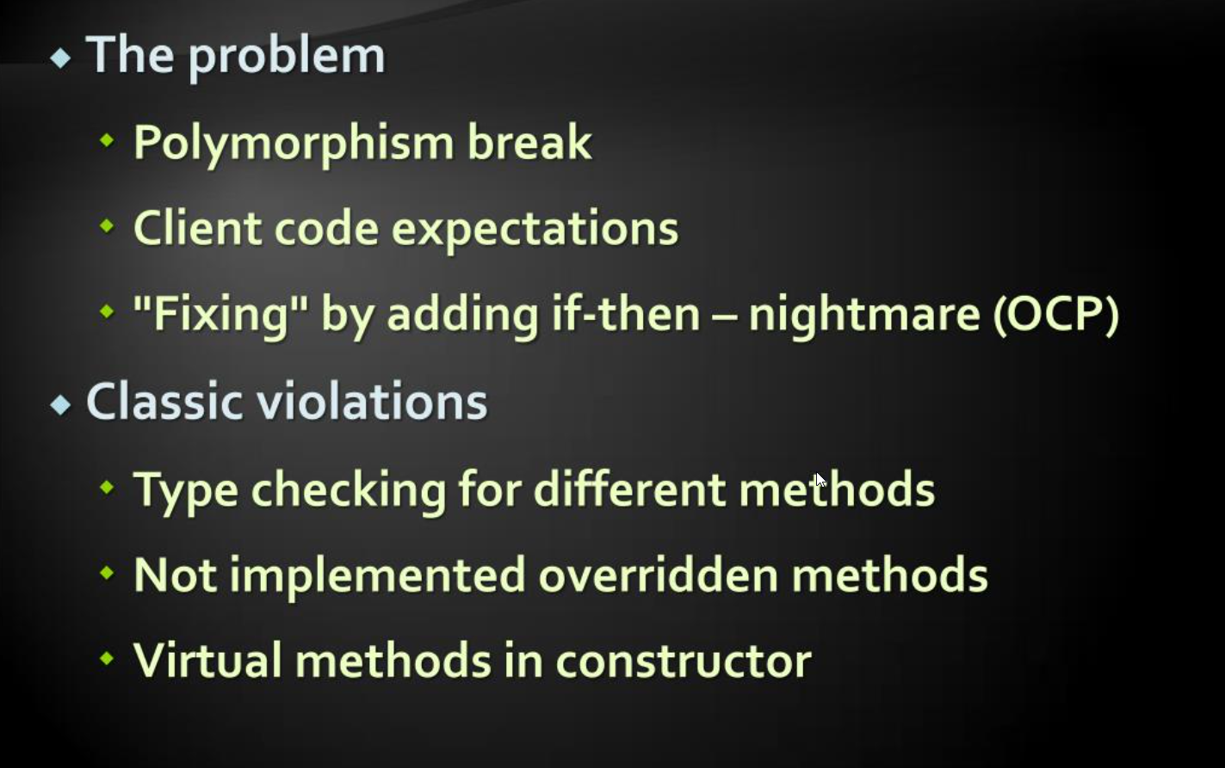

Slide 19
Liskov Substitution Live Demo

Slide 20
Interface Segregation Principle (ISP)
Make fine grained interfaces that are client specific. Client should not be forced to depend upon interfaces they don’t use.
Many small interfaces are preferred based on groups of methods, each one serving one submodule.".

Slide 21
Prefer small, cohesive interfaces
Divide fat interfaces into smaller ones
Having “fat” interface lead to
Classes having method they do not use
Increase coupling
Reduce flexibility
Reduce maintainability
Interface is:
All public members of class
the interface type
Parameters
Pass delegates / callback
Inheritance
Child types override behavior of a base class
Composition / Strategy pattern
Client code depends on abstraction
“Plug in” model

Slide 22
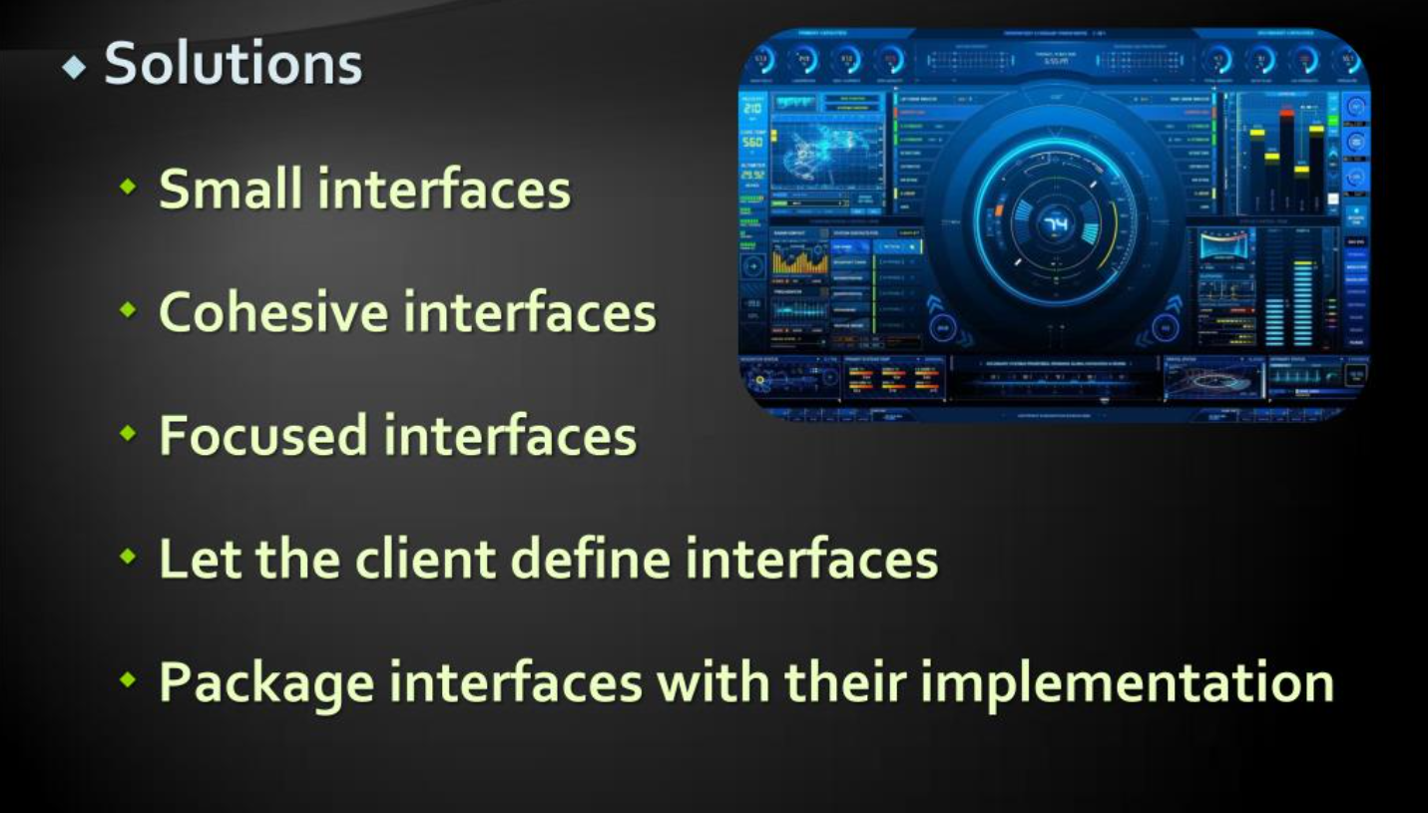

Slide 23
Interface Segregation Live Demo

Slide 24
Dependency Inversion Principle
Classes should not depend on solid classes but should only depend on abstraction (abstract classes or interfaces).
By following this approach, it makes the interchanging of modules and classes or services simple.

Slide 25
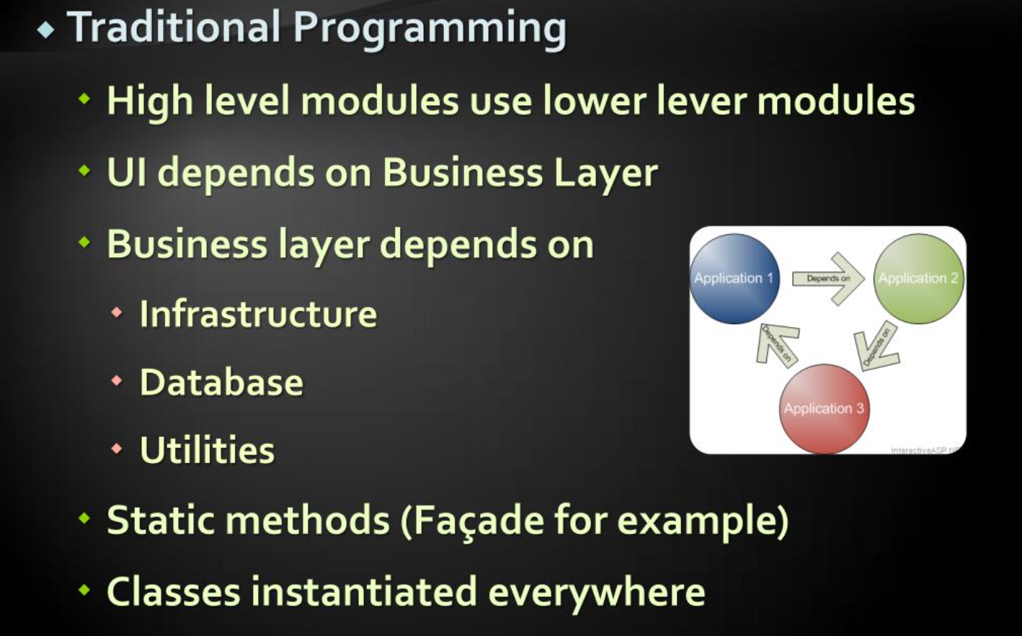
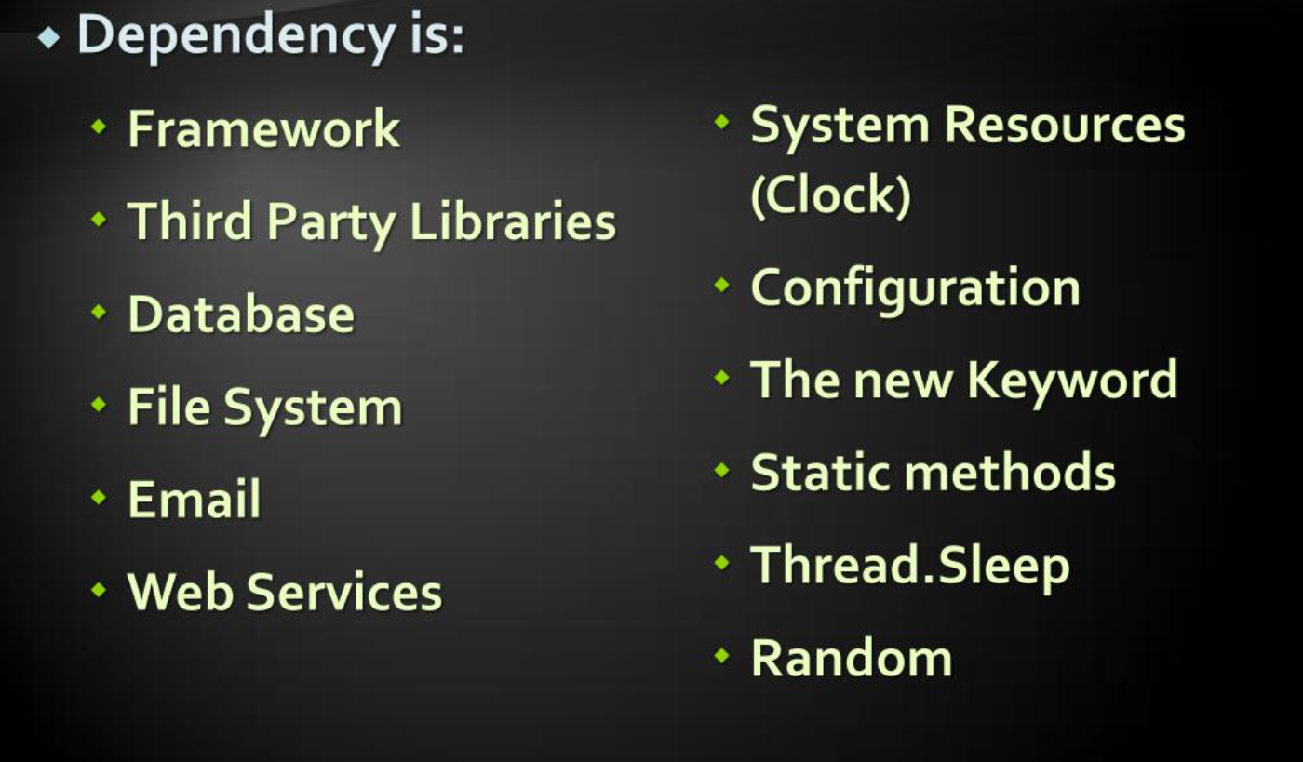

Slide 26
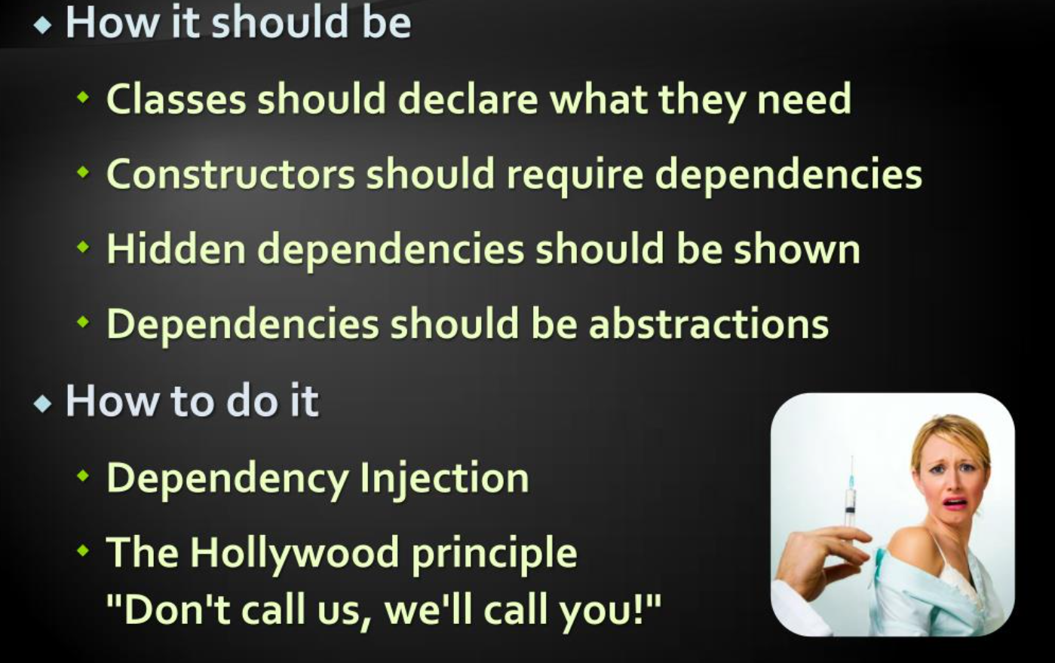
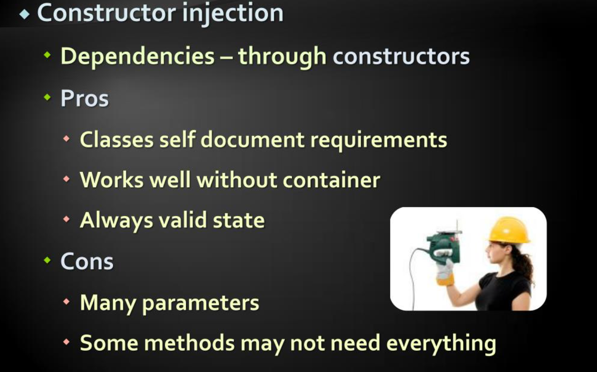

Slide 27
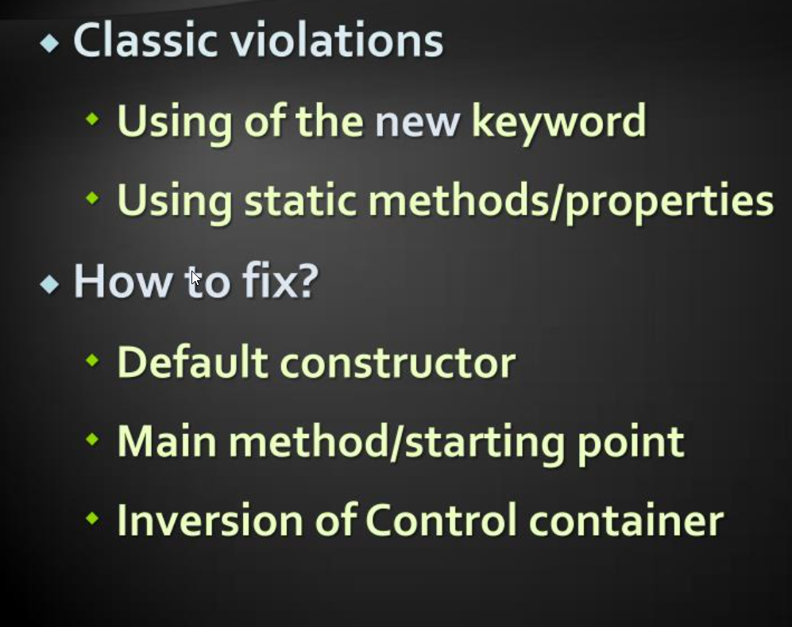
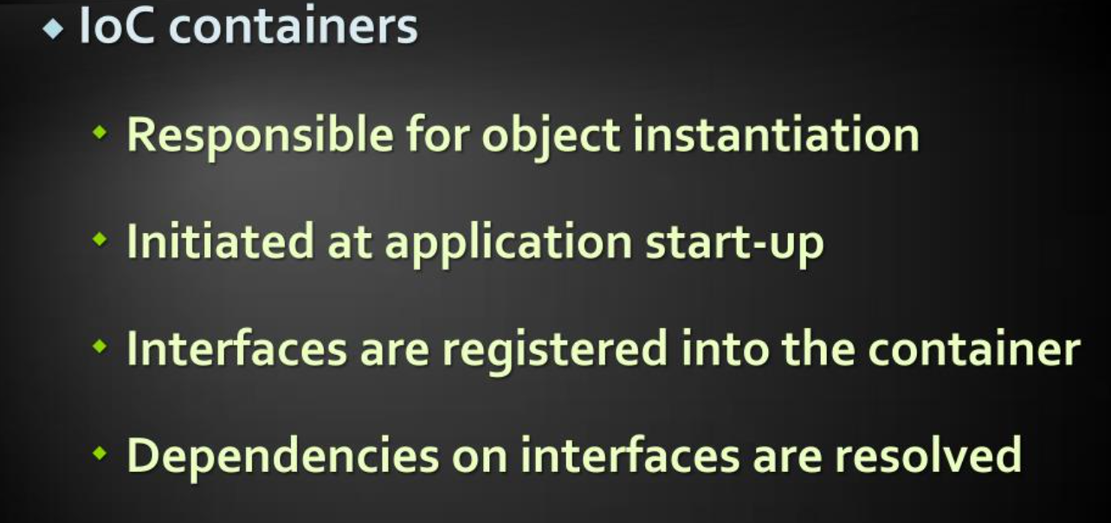

Slide 28
Dependency Inversion Live Demo

Slide 29
DRY – Don’t Repeat Yourself
Every piece of knowledge must have a single, unambiguous representation in the system.
Repetition in logic calls for abstraction. Repetition in process calls for automation.

Slide 30
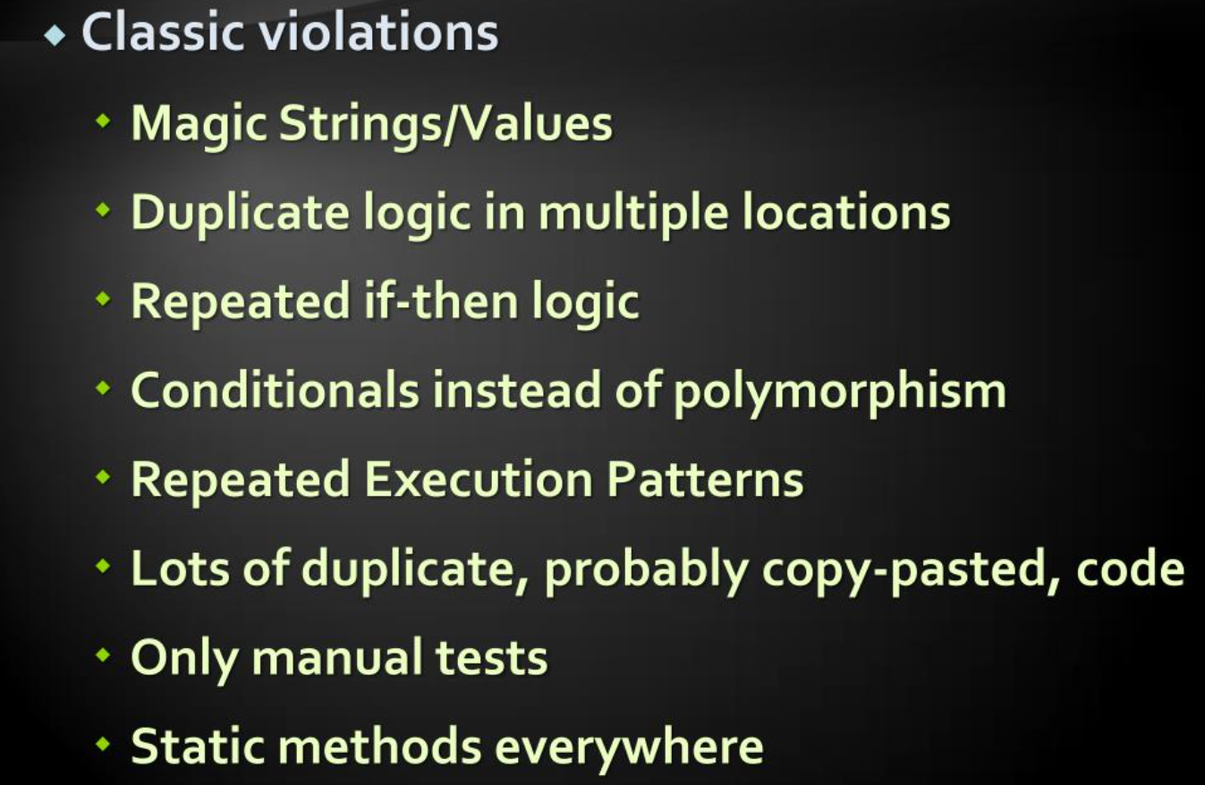

Slide 31
KISS - Keep it Simple, Stupid
Most system works best they are kept simple.
Simplicity should be a key goal in design and unnecessary complexity should be avoided.

Slide 32

Summary
Great, we have gone through all five SOLID principles successfully. And we can conclude that using these principles we can build an application with tidy, readable and easily maintainable code..

Slide 33


Thank You
Ashutosh

